Slide 1
Applied Physics Lecture no 02 Instructor: Maiza Zanib
Topic: Electric Forces & electric field with related problems.

Slide 2


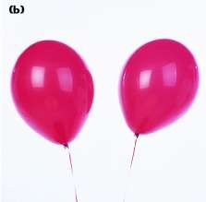
⁺ What is electric chargse?
In the top picture, the girl has rubbed the balloon on her hair, and now there is a force of attraction between them. Normally, a balloon and hair would not attract each other.
What happened to each to produce this force?
In the lower picture, the two balloons are repelling each other.
How was this force of repulsion produced?

Slide 3

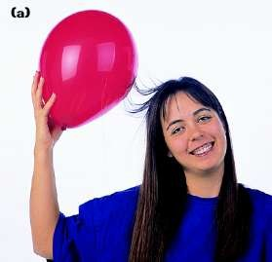
⁺ What do you think?
Suppose that after this balloon is rubbed against the girl’s hair, it is held against the wall. It will be attracted to the wall and stick to it.
Explain why the balloon is attracted to the wall.

Slide 4
Electric charge
Defination
“Electric charge is the basic physical property of matter that causes it to experience a force when kept in an electric or magnetic field.”
SI unit, Coloumb
Formula
Q=I.t

Slide 5
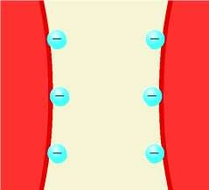
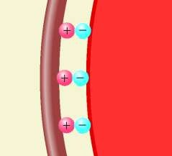
⁺ Electric Charge
There are two types of charge, positive and negative.
Like charges repel.
Positive and positive
Negative and negative
The two balloons
Opposite charges attract.
Positive and negative
The balloon and the hair.

Slide 6
⁺ Properties of Electric Charge
Work best on dry days because excessive moisture in the air can provide a pathway for charge to leak off a charged object.

Slide 7
Transferring Electric Charge
+
Atoms have smaller particles called protons (+ charge), neutrons, and electrons (- charge).
Number of protons = number of electrons
Atoms are neutral (no net charge).
Electrons are easily transferred from one atom to another.
Protons and neutrons remain in nearly fixed positions.

Slide 8
⁺ Transferring Electric Charge
When rubbing a balloon on your hair, electrons are attracted to the balloon and transfer.
The balloon is left with excess electrons (-charge).
The hair is left with an equal excess of protons (+charge).

Slide 9
⁺ Conductors and Insulators
What is meant by the term
electrical conductor?
Provide a few examples.
Conductors allow electrons to flow freely through them.
Silver, copper, aluminum, and
other metals
Electrons do not flow freely though insulators.
Plastic, rubber, glass
Outer electrons in metals are loosely bound to the nucleus and relatively free to move.
What is meant by the term
electrical insulator?
Provide a few examples.
Why do conductors and insulators behave differently?

Slide 10
⁺ Charging by Contact
Both insulators and conductors can be charged by contact.
Rubbing two materials together results in a transfer of electrons.
When charging metal, the charge may move through your body into the ground.
The metal and your body are conductors, so the charge moves through them.
You must hold the conductor with an insulating material, such as rubber gloves, to keep the charge on the metal.

Slide 11
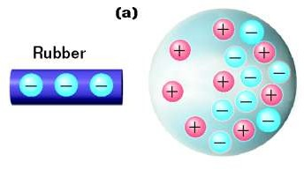
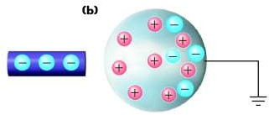
⁺ Charging by Induction
A charged rod is held near a metal sphere. Why do the charges in the metal arrange themselves as shown?
The metal sphere is connected to the ground with a conductor. Why did some of the electrons move off the sphere?

Slide 12
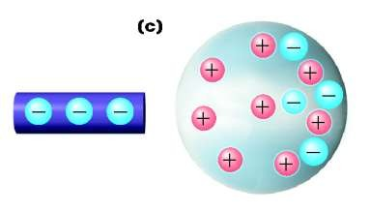
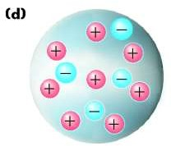
⁺ Charging by Induction
The conductor connecting the sphere to ground is removed. What type of net charge does the sphere now possess?
The negatively charged rod is removed. Why do the charges move into the positions shown?

Slide 13
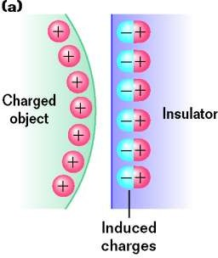
⁺ Surface Charges
Why does a charged balloon stick to the wall?
A positive surface charge is induced on
the wall by the negatively-charged balloon.
Electrons shift within atoms due to attraction or repulsion.
The insulator does not have a net charge.
The diagram shows the opposite case.
Why can a charged comb pick up little pieces of paper?

Slide 14
+
16.2 Electric Force

Slide 15
What do you think?
+
Electric forces and gravitational forces are both field forces. Two charged particles would feel the effects of both fields. Imagine two electrons attracting each other due to the gravitational force and repelling each other due to the electrostatic force.
Which force is greater?
Is one slightly greater or much greater than the other, or are they about the same?

Slide 16
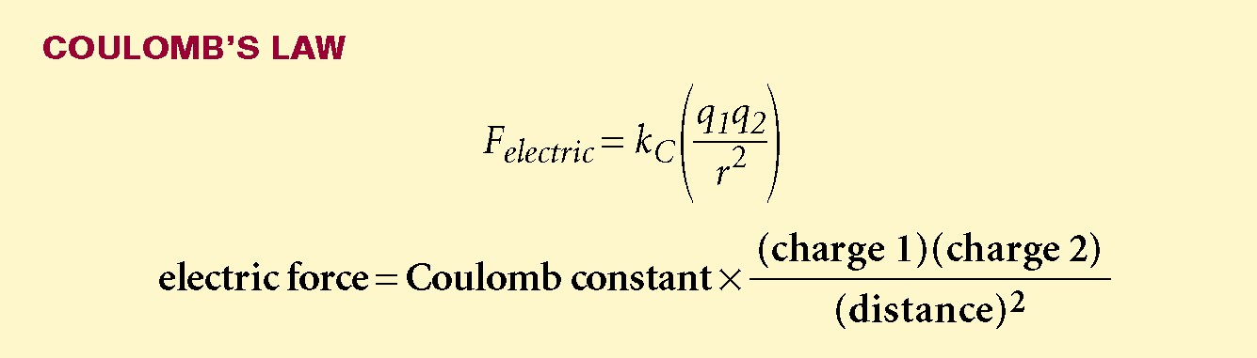
₊ Coulomb’s Law
The force between two charged particles depends on the amount of charge and on the distance between them.
Force has a direct relationship with both charges.
Force has an inverse square relationship with distance.

Slide 17


⁺ Coulomb’s Law
Use the known units for q, r, and F to determine the units of k_{c}.
k_{c} = 8.99 10⁹ N•m²/C²
The distance (r) is measured from center to center for spherical charge distributions.

Slide 18

⁺ Classroom Practice Problem
The electron and proton in a hydrogen atom are separated, on the average, a distance of about 5.3 10⁻¹¹ m. Find the magnitude of both the gravitational force and the electric force acting between them.
r= 5.3 x 10⁻¹¹
k_{c}= 8.99 x 10⁹
m_{e}= 9.109 x 10⁻³¹
m_{p}= 1.63 x 10⁻²⁷
q_{e}= -1.60 x 10⁻¹⁹
q_{p}= 1.60 x 10⁻¹⁹
G= 6.673 x 10 ⁻¹¹

Slide 19





⁺ Classroom Practice Problem
F k ( ^{q1q2} )
_{r} 2
e
c
( 1.6x10 ¹⁹ )(1.6x10 ¹⁹ )
9
F_{e} (8.99x10 )
(5.3x10 ¹¹ )²
F_{e} = -8.2
10⁻⁸ N

Slide 20




⁺ Classroom Practice Problem
m m
_{G} e p
F
_{r}2
F_{g} (6.673x10 )
g
(9.109x10 ³¹ )(1.63x10 ²⁷ )
11
(5.3x10 ¹¹ )²
F_{g} = 3.6
₁₀-47 _{N}

Slide 21
⁺ Classroom Practice Problem
The electric force is more than 10³⁹ times greater than the gravitational force.
Atoms and molecules are held together by electric forces. Gravity has little effect.

Slide 22
⁺ Electric Force
Like gravity, the electric force is a field force.
Similarities
Both forces are related to distance in the same way.
Differences
Two types of charge and only one type of mass
Electric forces can attract or repel while gravity only attracts.
Electric forces are far stronger than gravitational
forces.

Slide 23
Now what do you think?
+
Electric forces and gravitational forces are both field forces. Two charged particles would feel the effects of both fields. Imagine two electrons attracting each other due to the gravitational force and repelling each other due to the electrostatic force.
Which force is greater?
Is one slightly greater or much greater than the other, or are they about the same?

Slide 24
+
16.3 The Electric Field

Slide 25



What do you think?
+
Make a sketch of the “E” field for each charge or combination of charges.
How are your sketches similar?
How are they different?
Explain.

Slide 26
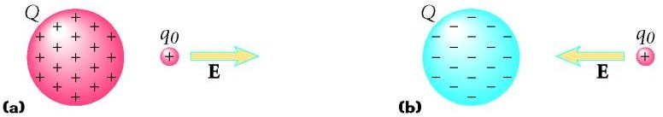

⁺ Electric Field Strength
Electric fields (E) have magnitude and direction.
The direction is defined as the direction of the force on a small, positive test charge (q₀) placed in the field caused by Q.
^{F}electric
The magnitude of the field is defined as the force per unit charge on q₀.
E
q₀

Slide 27
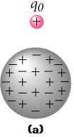
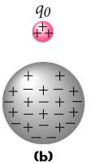
⁺ Test Charges
A small test charge will• not significantly affect the field.
If the test charge (q0) is large,
it will affect the way the
charges are distributed on the
charged conductor.
– This would change the field around the conductor.
Test charges will always be considered small
enough to have no effect on the field.

Slide 28
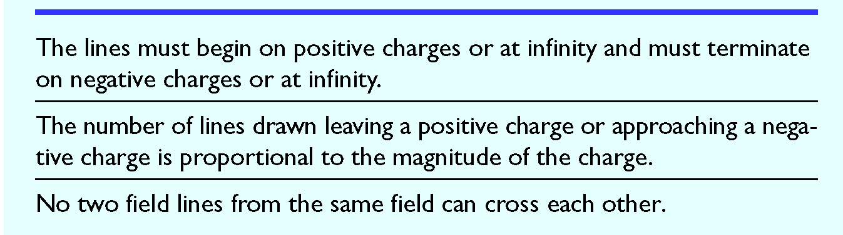
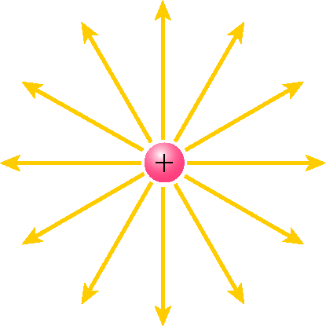

⁺ Electric Field Lines - Rules
Apply the above rules and sketch the E field around
the charge shown.

Slide 29
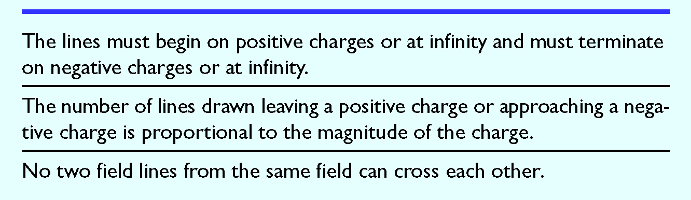
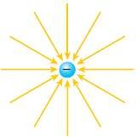

⁺ Electric Field Lines - Rules
Apply the above rules and sketch the E field around
the charge shown.

Slide 30
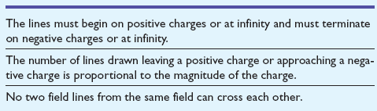

⁺ Electric Field Lines - Rules
Apply the above rules and sketch the E field around the charge combination shown.

Slide 31
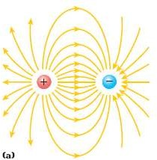
⁺ Electric Field Lines - Rules

Slide 32
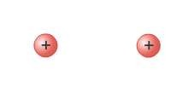
⁺ Electric Field Lines - Rules
Apply the above rules and sketch the E field around the charge combination shown.

Slide 33
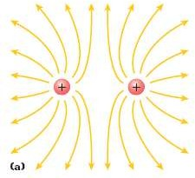
⁺ Electric Field Lines - Rules

Slide 34
Now what do you think?
+
What is an electric field?
When sketching electric fields, what information is conveyed by the direction of the field lines?

Slide 35
Thanks
Any Question?

